Slide 1


Regulating Uncertainty; Systemic Risk in the AI Act
SLSA Annual Conference
University of Liverpool
Samuel Carey
Stockholm University

Slide 2
A premise
“…we have not given nuclear power generation systems enough time to express themselves…we are only just beginning to uncover the potential dangers that make any prediction of risk very uncertain.”
Charles Perrow, Normal Accidents, 2011
Notes:
And in the same sense, these new AI models that are being developed have also not had enough time to express themselves. The risk associated with them are still relatively unknown, and even the dangers. Which gets to the crux of the problem with regulating emerging technologies, in so far as they are moving so quickly that it becomes difficult draft and implement legal frameworks which cand deal with them.

Slide 3
Outline
Motivation
Background
Systemic Risk
Legal Mechanisms
Three core problems

Slide 4
Motivation
Critically analyze the concept of systemic risk within the AI Act;
Does systemic risk generate more uncertainty than it resolves?
Highlight some of the problems with flexible regulation as a means of avoiding the pacing problem.
Notes:
So, the motivation for this research was the lack of clarity surrounding systemic risk and its late addition to the AI Act’s framework. Many of those who were following the drafting of the Act closely, who had essentially become accustom to the risk-based hierarchy of AI systems, were a bit shocked by the introduction of an entirely new category.
The release of CHATGPT in 2022 was one of the primary drivers for the inclusion of systemic risk and regulatory mechanisms large language models, what the EU now calls “General Purpose AI Models”. This lead to a bifurcation of the risk schemes in the AI Act, one for models and one for systems. However, this division I argue causes further uncertainties.
To borrow the expression from Perrow

Slide 5
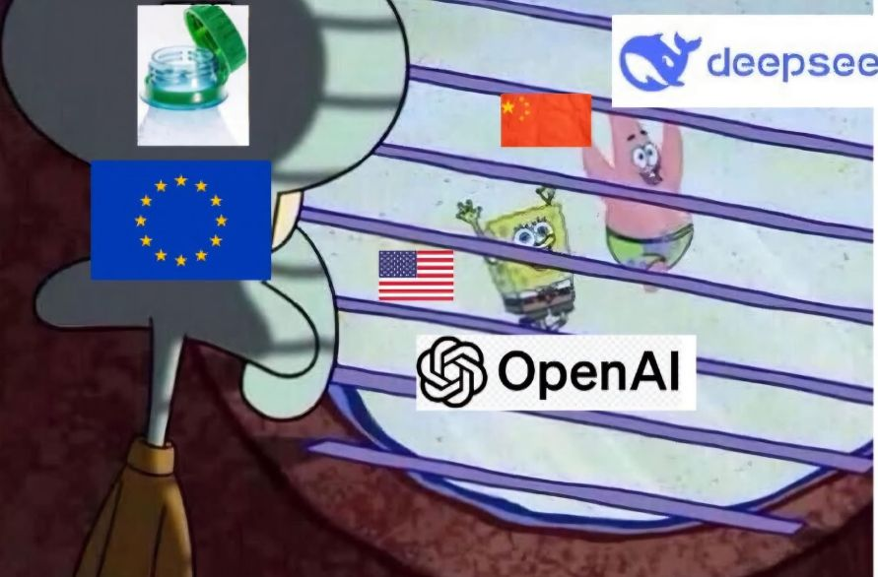
Background
Horizontal regulation, coming into force iteratively, began legally binding on 1 August 2024
Dual purpose: safeguard European values and fundamental rights, promote innovation.
Notes:
The AI Act is very different from for those who were used to the protection of fundamental rights through data protection. Unlike the GDPR, the AI Act has its heritage in the New Legislative Framework, which is a product liability framework often associated with childrens toys and elevators.

Slide 6
Systemic Risk
A new concept (OECD 2003 report)
Risk of breakdown in system, rather than just its parts, and is seen in the ”co-movements” between system parts [Kaufmann and Scott 2003]
Four components
Complexity
Uncertainty
Ambiguity
Ripple effects beyond the source of the risk
Notes:
The concept of systemic risk is a catch all term that refers to the increased interconnected, asymmetrical and globalized nature of risks. Its precise scope remains unclear, although its most often associated with financial markets, especially the 2008 financial crisis. However, as far as I can tell, the notion of systemic risk has its roots in an OECD report from 2003.
”Systemic risks entails endangering potentials with wide-ranging, cross-sectoral, or transnational impacts where conventional risk management and regional or even national risk regulation are insufficient” (Renn et al. 2022)
‘systemic risk’ means a risk that is specific to the high-impact capabilities of general-purpose AI models, having a significant impact on the Union market due to their reach, or due to actual or reasonably foreseeable negative effects on public health, safety, public security, fundamental rights, or the society as a whole, that can be propagated at scale across the value chain;
complexity, uncertainty, ambiguity, and ripple effects beyond the source of risk. Each component adds additional layers of difficult in regard to risk assessment. Complexity refers to the struggle to both identify and subsequently quantify due to the “multitude of potential elements and specific adverse effects.” In other words, the potential harm of a systemic risk is made up of competing causal components that to varying degrees lead to its categorisation as systemic. Complexity is increased due to the globalised nature of systemic risk, as well as the interconnectivity of their causal structures. Uncertainty refers to the indeterminacy of potential risks due to the variety of different components that make up the identification and measurement process. In a sense, uncertainty can be traced back to the competency and success of certain scientific methods to extract the necessary knowledge required to assess potential harms. Renn refers to this as systemic risks being “stochastic in their effect structure”, meaning that it is hard to predict with precision the occurrence of events and their consequence that relate to a particular risk. Ambiguity, unlike uncertainty, refers to the potential for interpretive differences between the results of scientific knowledge. Finally, ripple effects refer to the secondary and tertiary effects that occur through the unfolding of potential harms or impacts caused. Moreover, these secondary and tertiary effects can “jump across” various social domains or across various sectors. Therefore, the notion of systemic risk relates to the “totality of the threat – the probability that the entire system can collapse – that distinguishes systemic from other types of risk.”

Slide 7
Legal mechanisms
High-impact capabilities
Computational thresholds
Exceeding 10^25 FLOP
Ex officio decisions, implementing acts, delegated acts
Notes:
The AI Act operationalises2primary mechanisms for determining systemic risk in a model, the threshold of “high impact capabilities”, computational thresholds.
‘Ex officio decisions as well as implementing acts and delegated acts accordingly provide the flexibility in order to change
HIC - number of parameters, quality or size of it training data, quantity of computation used, input and output modalities, level of autonomy and scalability, reach in the internal market calculated through registered business users and the number of registered end-users
A general-purpose AI model is presumed to pose systemic risk where the cumulative computation used for training the model exceeds a floating-point per second score of 10^25. This includes all computational instances used to enhance the model, including pre-training, synthetic data generation and fine-tuning Alternatively, more than one YottaFLOP.

Slide 8
Three Core Critiques
The Institutionalisation of uncertainty
Law relies on science to define risk, but in the case of GPAI, there is a lack of consensus regarding the risks
Regulatory framework solidifies an inherently unstable concept
The delegation of systemic risk to Model providers
Risk of regulatory capture in the operationalisation of systemic risk
The creation of uncertainty between model and system.
The Act draws a line between GPAI and AI systems (for legal certainty)
Systems instantiate the risks embedded in models – yet systemic risk obligations are not extended to systems
Notes:
The institutionalization of uncertainty, as I call it, can be understood in two parts first, scientific uncertainty and regulatory uncertainty.
Risk based regulation can be paradoxical, in so far as they operate on the premise that certain social complexities can be “rationalized, ordered, managed and controlled”. The rigidity of regulatory frameworks often are unable to react and adapt to unforeseen and unpredictable futures, According to Black, this inability to adapt becomes institutionalized within regulatory frameworks. At the same time, the opposite is also true, where lack of clarity and certain in regards to the regulatory framework (less detailed rules and procedures) creates more uncertainty.
Another issue is that risk-based regulation operates on the implicit assumption of cause and effect. However, in the case of systemic risk, the normal cause and effect schemes breakdown and it becomes incredibly difficult to determine what happened and how it happened.
2) Delegation of risk decisions to private entities, in particular model providers
The
3)
Finally, I argue that the distinction between model and system in this case exacerbates the uncertainty of systemic risk. This creates a regulatory blind spot, where systemic risk is defined specifically as a proposentity of models rather than systems.
Models can be understood as a mathematical model that generates an inference or predication based on input data. Meaning that a model on its own is inherently incomplete – it does not

Slide 9
Summary
Issues with the use of technical standards such as compute as a way of determining systemic risk.
Tension between innovation and fundamental rights

Slide 10
Future research?
Evolution of systemic risk within the AI Act’s regulatory framework
Analysing the shifts in systemic risk through the different drafts of the Code of Practice

Slide 11
Thank you!
Stay in touch: Samuel.carey@juridicum.su.se

